Slide 1
Lecture 16
Economic Growth, Information and Cities
16.1 What is Economic Growth? Economic Theories (and their Flaws)
IUS 9.1
©Luís M. A. Bettencourt 2023
Notes:
This module briefly review the historical path and basics of endogenous economic growth theory. Towards the end, it motivates the study of these processes through the lens of cities.

Slide 2
Economic Growth
where do economic growth rates come from?
$$\frac{dY}{dt}=ηY$$
Exponential Growth: 2-3% a year for USA
noisy, scale dependent, variable
inequality
Notes:
There are a number of empirical facts about economic growth that are rather curious. First, economic growth at the rates we experience today are atypical in history, they became prevalent after the industrial revolution (but really since the 19th century). Economic growth in nations is approximately exponential, as shown, but the growth rate fluctuates over time and hides inequality of outcomes.

Slide 3
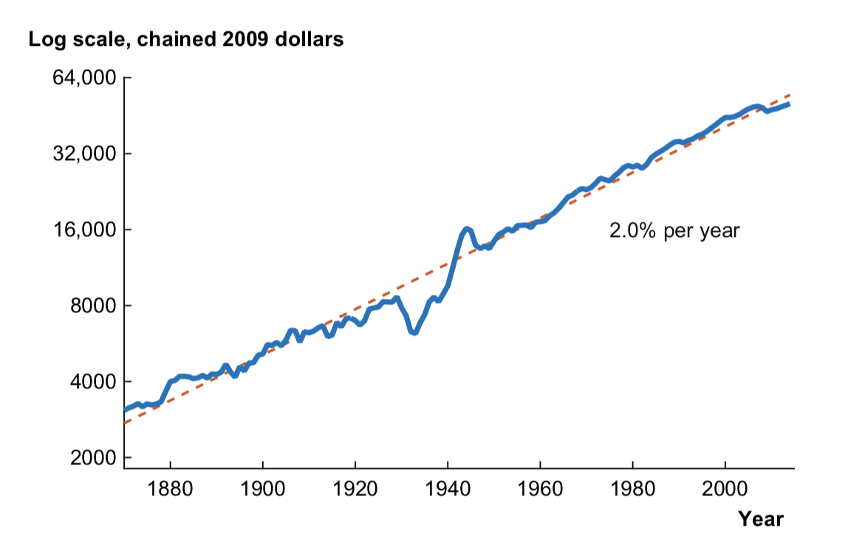
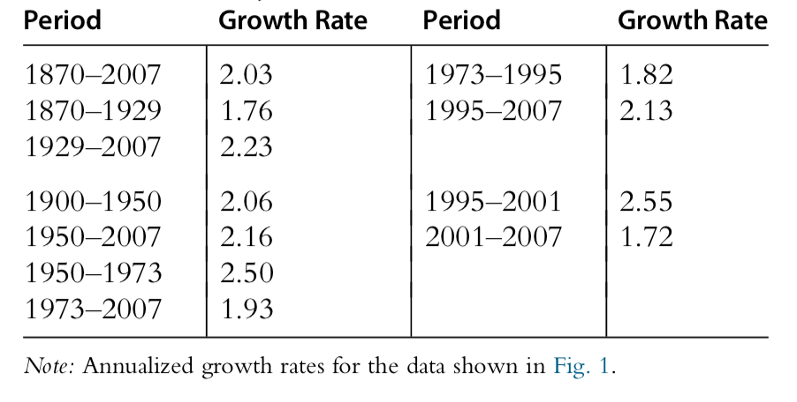
Economic Growth USA: 1870-2016
$$lnY$$
Growth at the “Frontier”
50%
urban
AMAZING !!
doubling every ~36 years.
Jones (2016)
https://www.nber.org/papers/w21142
Notes:
The US has been used by (US) economists as the paragon of economic growth. It is a remarkable fact that US GDP growth per capita adjusted for inflation has been growing at about 2% a year since the late 19th century. The wobbles are interesting: you can see the great depression ( a little bit) and the second world war. Remarkably the line picks up where it was heading afterwards. Some period (see table) such as the post WWII war were more prosperous than others, such as the last 2 decades.

Slide 4
We have now seen the nature of economic growth:
Exponential random processes
$$η$$
$$σ$$
Recall:
$$γ=η-σ^{2}/2$$
Growth rate
average growth rate
volatility
at different scales
maximize
minimize
Inequality
Knowledge and Optimal Investment
control: households, government
Objectives:
change through new knowledge
stability, resilience
Notes:
When we analyze economic growth at this level, we note that the stochastic growth rate can be decomposed in terms of an average and a volatility (standard deviation of temporal fluctuations). Maximizing growth requires maximizing the former, which we will show requires innovation, and minimizing the latter, which requires control and stability. These two objectives can become contradictory: unstable systems with small growth, can clamp down on innovation to promote stability, for example. Systems producing innovation can become very unstable, in this sense.

Slide 5
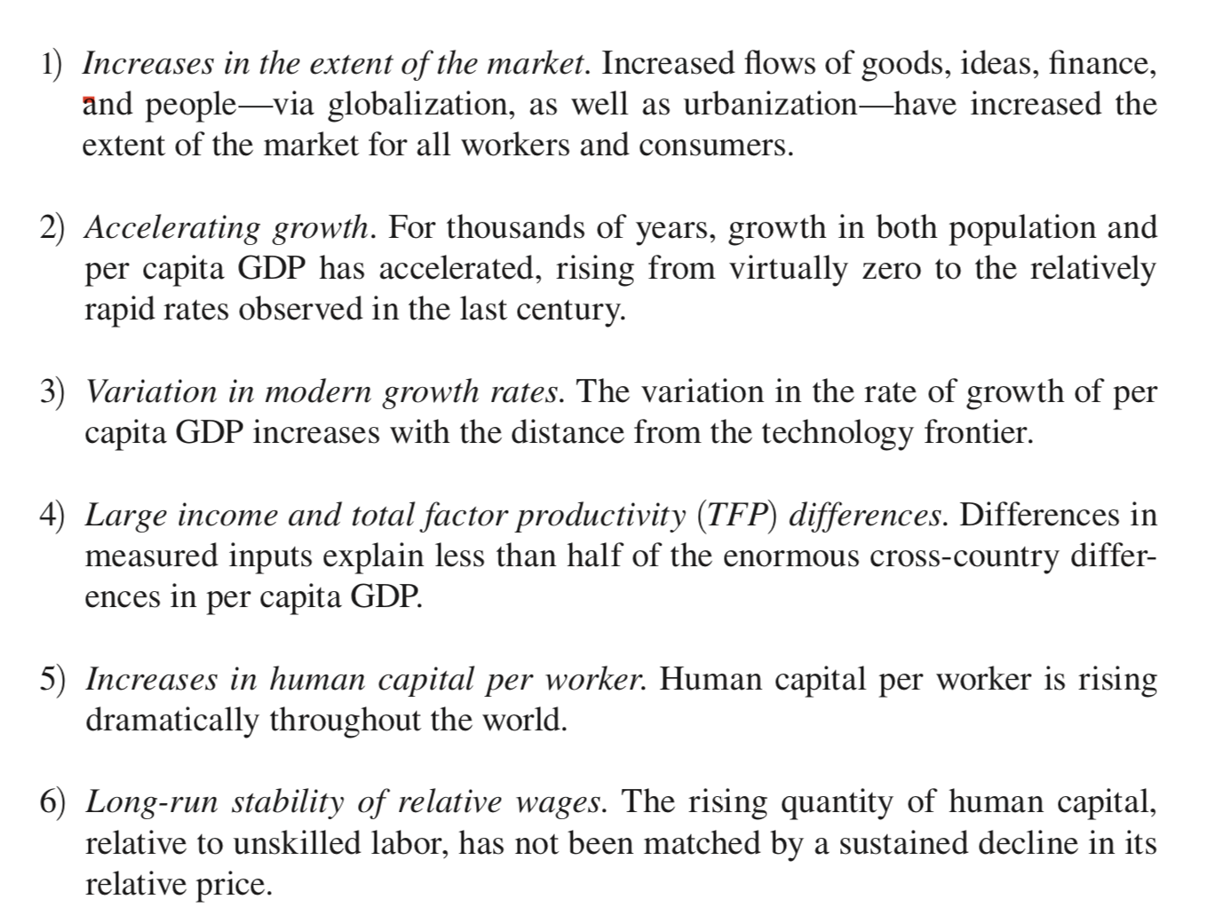
“Stylized” Facts about (national) Economic Growth
urban systems
“Smith’s Theorem”: wealth is proportional to the extent of “the market”
see next lecture
wealth is NOT from labor or capital
=education and training
education does not
depreciate (much)
Jones and Romer (2010)
https://www.nber.org/papers/w15094
Notes:
There is a lore ( what the economists call “stylized facts”) about the main properties of economic growth. This is a little thick w jargon, but a lot of it is about the properties of cities, as we have seen already.

Slide 6
The Economy as a Production Device
(basic economic theory)
Cobb-Douglas production function
$$Y(t)=A(t)L^{α}(t)K(t)^{1-α}$$
total production
GDP
labor
capital
total factor
productivity
TFP
This is like a recipe, say to bake a cake
Each unit of produced output needs both labor and capital
in some fixed proportion
$$\frac{α}{1-α}$$
Notes:
Economists use a production function, a very rough model of the economy as an input-output device to analyze what causes economic growth: The idea is that total income is the sum of wages and rents (profits from capital), in certain proportions (alphas). This is a bit like making a cake, and saying that for each unit of income (cake) you need alpha wages and 1-alpha capital. The constant in front (A) is called the total factor productivity, and is where all the cation is, as we will see.

Slide 7
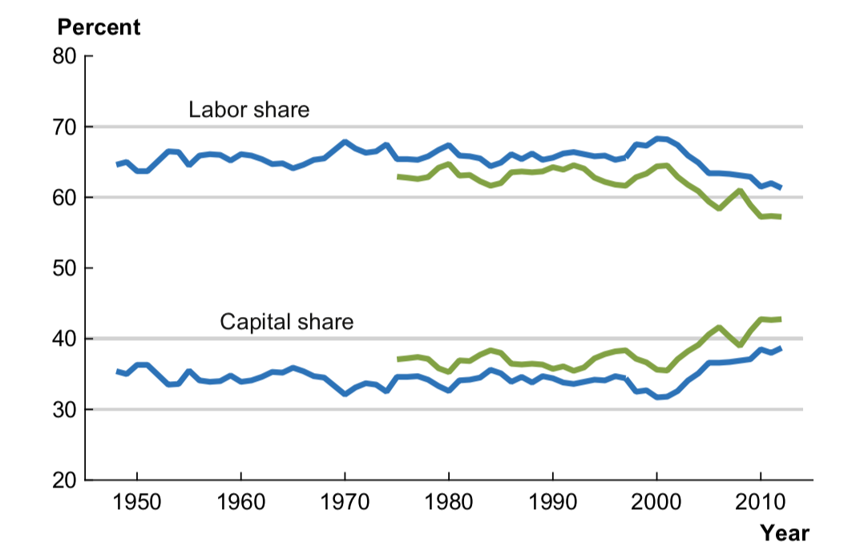
$$Y(t)=W(t)+R(t)$$
total income
wages
rents (profits)
$$1=\frac{W(t)}{Y(t)}+\frac{R(t)}{Y(t)}=α+(1-α)$$
fraction of income
given to wages
$$α$$
remember Piketty and Stieglitz
Jones 2016
https://www.nber.org/papers/w21142
Notes:
Here is the same scheme, and a couple of measures of the fraction of wage in national income, Note that for the US it has been 60-70% for a long time, but recently it is heading down, while capital rents up. This is another reason why inequality has been on the rise. There is no fundamental argument, to my knowledge, for what number \alpha should be.

Slide 8
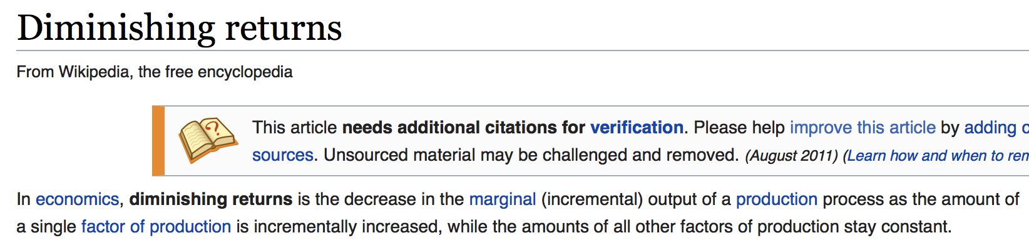
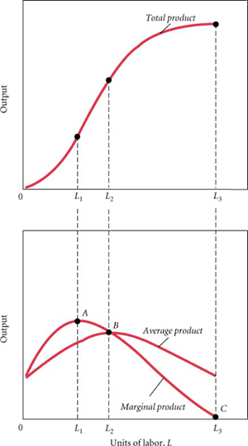
Extensive Growth
diminishing returns
$$Y∼L^{α},α<1$$
Negative feedback !!
slows down growth
marginal
stabilizes the economy
$$\frac{d}{dL}Y∼L^{α-1}$$
“General Equilibrium”
Notes:
Now, the main argument, because \alpha < 1 by construction, is that economic growth cannot follow from increases in input labor and capital (that is called extensive growth), but from increases in productivity for those factors held fixed. That is increase in A. The other factors are subjected to “decreasing returns” as shown here.

Slide 9
Deriving the Production Function
$$Y(t)=W(t)+R(t)$$
take the variation:
$$dY(t)=dW(t)+dR(t)$$
$$\frac{dY(t)}{Y(t)}=\frac{W(t)}{Y(t)}\frac{dW(t)}{W(t)}+\frac{R(t)}{Y(t)}\frac{dR(t)}{R(t)}=α\frac{dW(t)}{W(t)}+(1-α)\frac{dR(t)}{R(t)}$$
$$Y(t)=Y_{0}W^{α}(t)R^{1-α}(t)$$
$$R=rK,$$
$$W=wL$$
rent from capital
wages
$$Y(t)=A(t)L^{α}(t)K^{1-α}(t)$$
with
$$A(t)=Y_{0}w^{α}(t)r^{1-α}(t)$$
https://journals.plos.org/plosone/article?id=10.1371/journal.pone.0058407
Notes:
And here is how you derive the (Cobb-Douglas) production function, and the meaning of A, in terms of increasing productivity (money income per unit of labor and capital).

Slide 10
$$\frac{d}{dt}lnY(t)=\frac{d}{dt}lnA(t)+α\frac{d}{dt}lnL(t)+(1-α)\frac{d}{dt}lnK(t)$$
economy’s
growth rate
population
growth rate
capital
growth rate
what we want to know
extensive growth
not very interesting or important
intensive growth
This is the interesting question!!
what sets the growth in A?
total factor productivity
Notes:
OK, back to the point: what we want to know is why and when there can be exponential growth in A. This is called intensive growth, which is expected to be endogenous to the nation if it takes the appropriate actions. What are these?

Slide 11
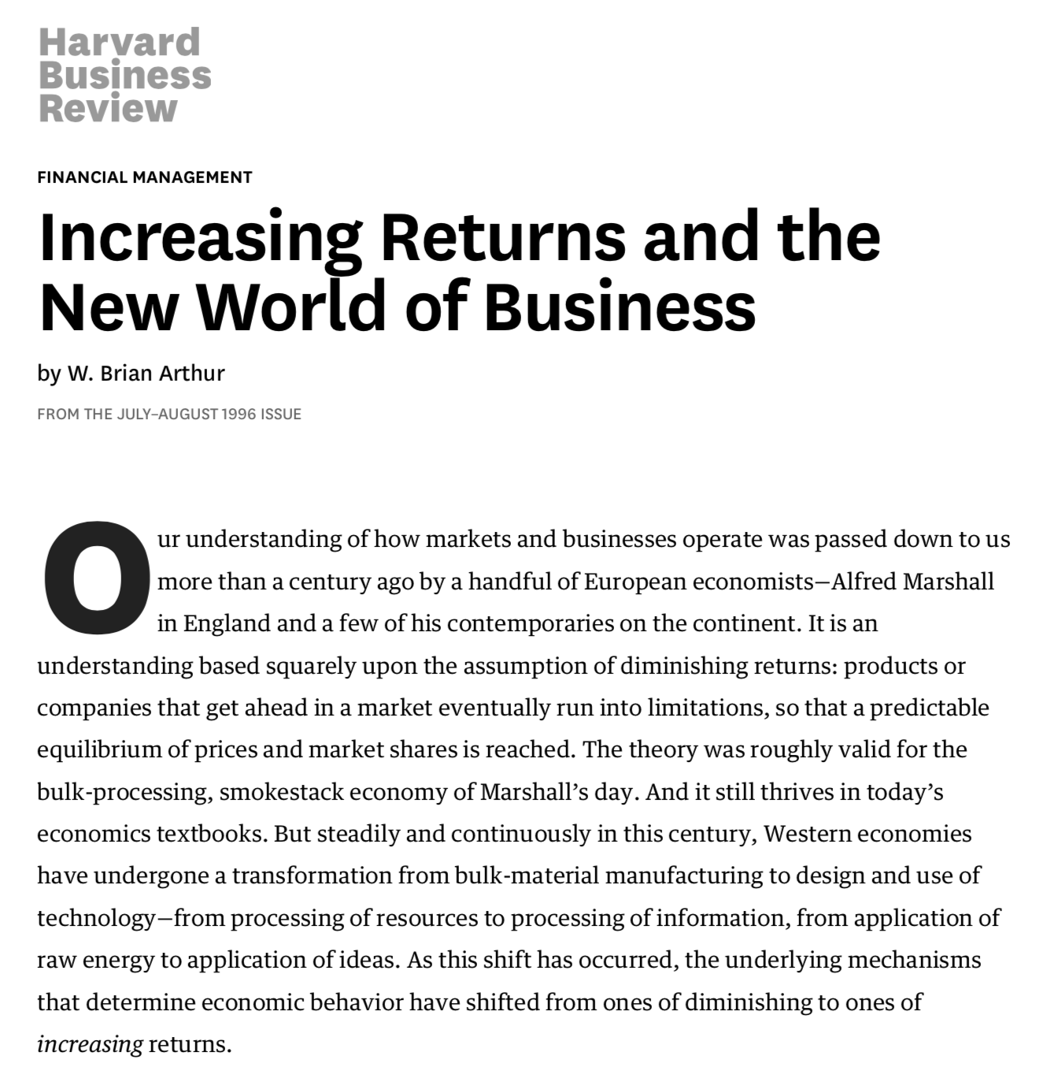
Positive Feedback !
$$\frac{d}{dt}lnY(t)∼\frac{d}{dt}lnA(t)$$
no reason for slow down !!
knowledge wealth
Open-Ended Growth
https://hbr.org/1996/07/increasing-returns-and-the-new-world-of-business
Notes:
The answer of how to evade decreasing returns to scale, typical of the uses of material inputs, like labor and capital is to use something that has a different character: namely knowledge. Or information. The idea is that by using a better recipe (better knowledge) we can make a more valuable cake, using the same inputs. This idea became clear with the dawn of the information economy, as discussed in this paper.

Slide 12
OK, but what is in A that can grow exponentially?
Romer (1990)
Answer: Knowledge
https://www.jstor.org/stable/2937632
Why?
decreasing returns occur because inputs are expended (materials and energy)
but knowledge is a “non-rival” good
-> “Positive Externality”:
knowledge can be used indefinitely without being spent
if A is made of knowledge, there are no decreasing returns !!
Notes:
These ideas were eventually formalized by Paul Romer (who won the Econ Nobel prize for it). He built a model where knowledge is an non-rival input to production, meaning that it does not get used up, leading to the lifting of limitations to growth, creating what economists call a positive externality.

Slide 13

Still need to explain how A that can grow exponentially?
simple models and the scale problem:
Jones 1999
https://www.jstor.org/stable/2937632
$$Y(t)=A^{σ}(t)L(t)$$
(forget about capital)
growth of A:
“knowledge employment”
$$σ>0$$
$$\frac{d}{dt}lnA(t)=aL_{A}=g_{A}$$
$$L=L_{A}+L_{Y}$$
total
population
worker
population
growth of economy per capita:
knowledge-creator
population
$$g_{Y}=\frac{d}{dt}ln\frac{Y(t)}{L(t)}=σasL$$
$$L_{A}=sL,L_{Y}=(1-s)L,0<s<1$$
$$g_{Y}=σasL_{0}e^{g_{L}t}$$
totally wrong!
$$\frac{d}{dt}lnL(t)=g_{L}→L(t)=L_{0}e^{g_{L}t}$$
grows exponentially!!
Notes:
There have been many models for endogenous economic growth. They all share a certain sickness, in that they need to be extremely fine-tuned in parameters or they are non-sensical. This is reviewed by Jones. The problem is that these models tend to over-estimate the growth rate of the economy based on the growth of researchers, patents, inventions, etc. It’s not even close.

Slide 14
conundrum:
A must grow exponentially in time to match growth of GDP
Measurements of knowledge also are observed to grow exponentially:
populations of researchers
papers
patents
These quantities set the growth rate of A:
exponential of exponential
WRONG !!
if any of these drive the growth of A, it will grow too fast !
Notes:
Here’s the problem in a nutshell. Note that though these models speak of knowledge, they really are not describing what it is, and there’s no notion of real information.

Slide 15


This turns out to be a general issue, not yet solved:
Questions?
Who’s knowledge?
Bob Lucas
How is it created?
https://www.sciencedirect.com/science/article/pii/0304393288901687
How is it integrated in production?
Jane Jacobs
It has to be a collective good:
“external human capital”
“Institutions”
Acemoglu and Robinson
https://www.nber.org/papers/w10481
“What can people be paying Manhattan or downtown Chicago rents for, if not for being near other people?”
Notes:
Another branch of this literature, due to Bob Lucas, introduces the importance of cities and of Jane Jacob’s wisdom. His argument is that there must be something special about cities as networks of people in terms of information that is very valuable as seen in rents.

Slide 16
As Jacobs has rightly emphasized and illustrated with hundreds of concrete examples, much of economic life is 'creative' in much the same way as is 'art' and 'science'.
New York City's garment district, financial district, diamond district, advertising district and many more are as much intellectual centers as is Columbia or New York University.
The specific ideas exchanged in these centers differ, of course, from those exchanged in academic circles, but the process is much the same. To an outsider, it even looks the same: A collection of people doing pretty much the same thing, each emphasizing his own originality and uniqueness.
Considerations such as these may convince one of the existence of external human capital, and even that it is an important element in the growth of knowledge.
Her emphasis on the role of cities in economic growth stems from the observation that a city, economically, is like the nucleus of an atom: If we postulate only the usual list of economic forces, cities should fly apart. The theory of production contains nothing to hold a city together. A city is simply a collection of factors of production - capital, people and land - and land is always far cheaper outside cities than inside.
It seems to me that the 'force' we need to postulate account for the central role of cities in economic life is of exactly the same character as the 'external human capital' I have postulated as a force to account for certain features of aggregative development.
If so, then land rents should provide an indirect measure of this force, in much the same way that schooling-induced earnings differentials provide a measure of the productive effects of internal human capital.
What can people be paying Manhattan or downtown Chicago rents for, if not for being near other people?
Lucas (1988)
https://www.sciencedirect.com/science/article/pii/0304393288901687
Notes:
Here is the passage from his paper … the stuff about the nucleus of the atom is a bit off, but he is trying to say that people benefit from the knowledge of everybody around them.

Slide 17
Lucas and “External Human Capital”
$$Y(t)=A(t)K^{1-α}(t)L^{α}(t)→AK^{1-α}(t){\left[u(t)h(t)L(t)\right]}^{α}h_{a}(t)^{γ}$$
fixed “technology”
individual
human capital
“external”
human capital
diminishing returns
human capital accumulation is a social activity,
involving groups of people in a way that has no counterpart in the accumulation of physical capital. “
ecological effect
Notes:
He builds a model for this that also does not work very well, but the idea is good. He runs in trouble because his external human capital h(t) will also need to grow exponentially …

Slide 18
Need a Theory of (productive) Knowledge in Cities
why can the collective system keep growing
even if individual knowledge doesn’t ?
Notes:
So we need a better theory, in fact a better theoretical framework. It turns out that the answer will come from quite a different place, from statisticians and information theorists interested in gambling and the stock market.

Slide 19

a flawed but fascinating story:
http://www.fortunesformula.com
Notes:
This book tells us the history of some of these ideas. The answer is that there are optimal strategies to learn and invest, no matter the context, and that the growth rate is information itself. More in the next lecture.

